Slide 1

Navigating the APC Ladder Website

Slide 2
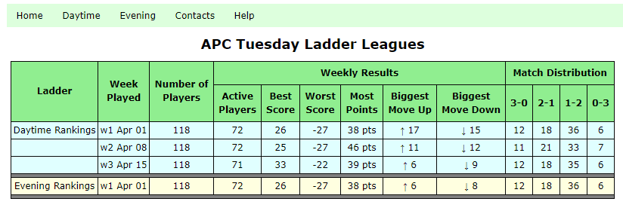
Welcome to the APC Ladder
The home page is shown below
This shows a summary of the results to date for the APC Tuesday leagues. The weekly results show the range of performance (best and worst) along with the match distribution
Use the menu bar to navigate through the Daytime and Evening league information
Get your rakings, schedules, and match scores

Slide 3
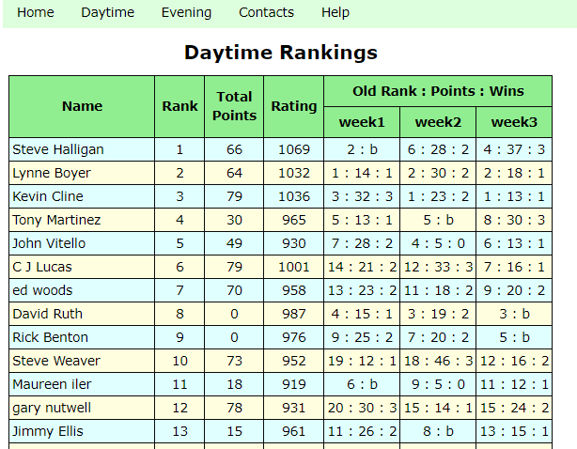
Player Rakings and week-to-week history
Got here by clicking:
Daytime
Rankings
This page shows how each player in the league has performed
There are 3 performance parameters: Rank, Total Points, and Rating
Rank: your current position on the ladder
Total Points: the accumulates points your have won this session
Rating: an independent measure of your playing prowess relative to the other ladder players
Performance History: Old Rank:Points:Wins
E.g. Steve H for week3 = 4: 37 : 3
He was ranked 4th, he got 37 pts this week, and won 3 games in his match
If you did not play on a given week, e.g. 2: b, the numbers are your old rank and a ‘b’ for bye

Slide 4
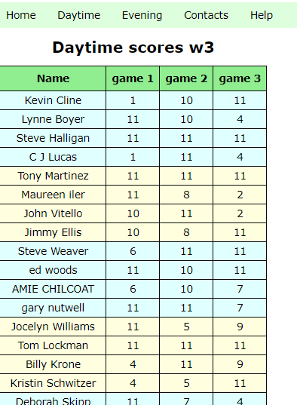
Weekly Scores
Got here by clicking:
Daytime
Scores
Each match consists of 3 games played to 15 (or 11), win by 1
This page show the score for all the matches played on a given week

Slide 5
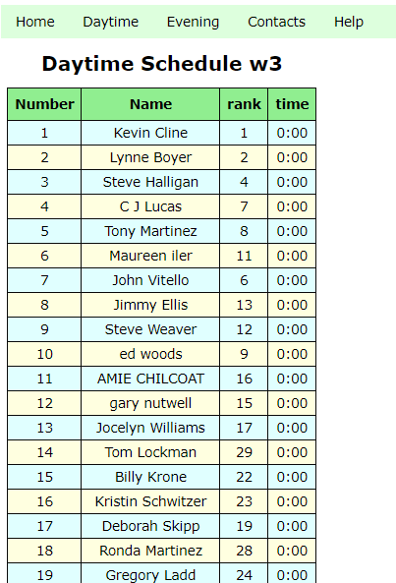
Weekly Schedule
Got here by clicking:
Daytime
Schedule
The league manager will post the weekly schedule 1 or 2 days before matches will be played
The schedule list the match time for every player.
If you are not on the list, but plan to play, contact the manager as soon as possible.
Also, if you are on the list but do NOT plan to play, let the manager know as soon as possible

